Slide 1
Cybercrime-as-a-Service (CaaS) LOLBins and QBot (Qakbot) Attacks
By: Koo Wai Kit (TP081761)

Slide 2
TABLE OF CONTENTS
01
04
02
OVERVIEW OF LOLBINS & QBOT
VULNERABILITIES ENABLING QBOT ATTACKS
03
TTPs OF QBOT ATTACKS
CYBERSECURITY STRATEGIES AGAINST LOLBINS ATTACK
Notes:
Overview of LOLBINS & QBot
Definition and concept of LOLBins.
How attackers exploit LOLBins.
Background and evolution of QBot.
Capabilities and functionalities of QBot.
Vulnerabilities Enabling QBot Attacks
Overview of key vulnerabilities (e.g., CVE-2021-34527, CVE-2022-30190).
How these vulnerabilities facilitate QBot attacks.
TTPs of QBot Attacks
Intrusion tactics used by QBot attackers.
Attack techniques QBot employs.
Detailed attack procedures associated with QBot.
Cybersecurity Strategies Against LOLBINS attack
Threat Modeling for QBot.
Operational Security (OPSEC) measures to mitigate QBot attacks.
General security strategies.
Technical security measures including preventative, detective, and corrective controls.
Conclusion
Summarize key takeaways and emphasize the importance of proactive cybersecurity measures.

Slide 3
OVERVIEW OF LOLBINS & QBOT
01

Slide 4
LOLBINS (Living Off the Binaries)
Legitimate system binaries/tools exploited for malicious purposes.
Evade detection by using trusted system utilities.
Mechanisms of Exploitations
Bypassing Security Measures:
Run arbitrary code with trusted binaries, bypass application whitelisting and traditional defenses.
Covert Execution:
Conduct malicious activities within normal system processes.
Privilege Escalation:
Gain higher access by exploiting vulnerabilities or misconfigurations.
Lateral Movement:
Use basic utilities to navigate and exploit additional targets within networks.
Data Exfiltration:
Extract and transfer sensitive data using system tools, avoiding standard Data Loss Prevention (DLP) measures.
Remote Command Execution:
Remotely execute commands on compromised systems, enabling further malicious activities.

Slide 5

QBot (QakBot)
ORIGINS
EVOLUTIONS
First discovered in 2007 as a banking trojan designed for stealing financial information and committing fraud.
Became a versatile malware, now mainly an initial access broker deploying tools like Cobalt Strike, leading to secondary infections like Black Basta ransomware.
HIGH-PROFILE ATTACKS
Adaptation:
In 2021, QBot was involved in attacks on JBS, the world’s largest meat producer, and Fujifilm, a Japanese multinational, both linked to the REvil gang.
“Operation Duck Hunt” → a multinational operation to shutdown QBot in 2023, but a new version was released soon after.
To date, 5 versions have been released.

Slide 6
02
VULNERABILITIES ENABLING QBOT ATTACKS

Slide 7
Recent CVE Vulnerabilities Exploited by QBot
A
B
C
D
E
CVE-2021-34527
CVE-2022-30190
CVE-2023-36033
PrintNightmare
Follina
CVE-2024-30040
CVE-2024-30051

Slide 8
CVE-2021-34527 (PrintNightmare)
CVSS Score: 8.8
Allows attackers to execute arbitrary code remotely with system-level privileges.
QBot uses this to gain elevated access, facilitating its lateral movement and persistence.
Affects the Windows Print Spooler service.
Severity: High

Slide 9
CVE-2022-30190 (Follina)
CVSS Score: 7.8
QBot initiate attacks via malicious Office documents that contain embedded malicious payloads.
Allows attackers to perform remote code execution with the privileges of the calling application (e.g., MS Word)
Affects the Microsoft Windows Support Diagnostic Tool (MSDT).
Severity: High

Slide 10
CVE-2023-36033
CVSS Score: 7.8
Allows attackers to gain system privileges on a compromised system by exploiting an untrusted pointer dereference (CWE-822).
QBot uses this for gaining system privileges and performing high-privilege operations.
Affects the Windows Desktop Window Manager (DWM) core library.
Severity: High

Slide 11
CVE-2024-30040
CVSS Score: 8.8
Allows attackers to bypass security features in Microsoft 365 and Office.
QBot tricks users into loading malicious documents (Word, Excel etc.) to execute arbitrary code.
Affects Windows MSHTML platform.
Severity: High

Slide 12
CVE-2024-30051
CVSS Score: 8.8
Allows attackers to escalate privilege on the affected system.
QBot triggers the buffer overflow, escalating its privileges to system-level on the compromised machine.
Affects Windows Desktop Window Manager (DWM), caused by a heap-based buffer overflow.
Severity: High

Slide 13
TTPs OF QBOT ATTACKS
03

Slide 14
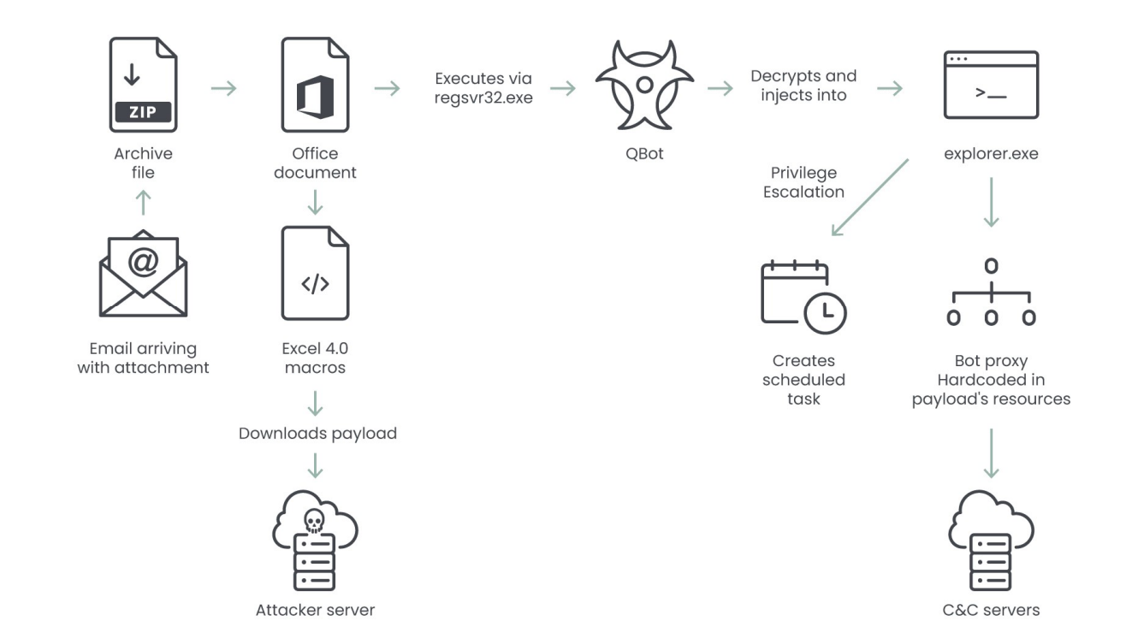
QBot Attack Flow

Slide 15
Phishing
→ spearphishing attachments / links
Exploit Vulnerabilities
→ exploit vulnerabilities in remote services
PowerShell Scripting
uses PowerShell scripts to execute malicious payloads
DLL Hijacking
→ loads and executes malicious DLL files to run its code within legitimate processes
Boot or Logon Autostart Execution
modifies Startup Folder / Windows Registry to automatically execute QBot when the system starts or when a user logs in
Initial Access
Execution
Persistence
QBot TTPs

Slide 16
Obfuscated Files or Information: Fileless Storage
→ stores and executes malicious code directly in memory, bypass file-based security measures
Impair Defenses
→ disables or modifies security tools and defenses to prevent detection and removal
Credentials from Password Stores
→ retrieve credentials stored in web browsers
Input capture
→ captures keystrokes to collect sensitive information
Process Injection
→ QBot inject its code into a legitimate process
Privilege Escalation
Defense Evasion
Credential Access
QBot TTPs

Slide 17
Data from Local System
→ gathers data from the compromised system, including documents, files, and other sensitive information
Exfiltration Over C2 Channel
→ exfiltrates stolen data over its command-and-control (C2) channels, often encrypting or encoding the data to avoid detection during transmission
Application Layer Protocol: Web Protocols
→ communicates with its C2 servers using standard web protocols to blend in with normal web traffic and avoid detection
Collection
Exfiltration
Command and Control
QBot TTPs

Slide 18
04
CYBERSECURITY STRATEGIES AGAINST LOLBINS ATTACK

Slide 19
Operational Security (OPSEC) Plan
01
03
02
04
Identify Critical Information
Assess Vulnerabilities
User credentials, endpoint devices, email systems, network infrastructure, security software configurations
Outdated software, weak email security, lack of endpoint protection, unsecured network configurations, insufficient user training
Analyse Threats
Evaluate Risk
External hackers, insider threats, Advanced Persistent Threats (APTs), malware developers
Likelihood of phishing success, impact of credential theft, severity of lateral movement, effectiveness of current defenses
5-steps process

Slide 20
Operational Security (OPSEC) Plan
05
Apply Countermeasures
Email Filtering and Security: Use advanced solutions to detect and block phishing attempts.
Endpoint Detection and Response (EDR): Deploy EDR to monitor and respond to LOLBins and suspicious activities.
Software Updates and Patching: Regularly update systems and applications to mitigate vulnerabilities.
Network Segmentation: Isolate critical systems to prevent QBot from lateral movement.
User Training Programs: Educate employees on phishing, email verification, and reporting suspicious activity.
5-steps process

Slide 21
General Security Plan
Authentication
SSL/TLS and Certificates
Multi-factor authentication (MFA), strong password policies
Enforce SSL/TLS, certificate management
Authorization
Single-Sign-On (SSO)
Role-based access control (RBAC), least privilege principle
Centralised identity management, MFA integration
Encryption
Lightweight Directory Access Protocol (LDAP)
Data encryption (AES-256, End-to-End), full disk encryption
Centralized authentication and authorisation, secure LDAP communications

Slide 22
Technical Security Plan
01
02
03
Preventative Measures
Firewall, intrusion prevention system (IPS), multi-factor authentication (MFA), antivirus
Detective Measures
Intrusion detection system (IDS), honeypots
Corrective Measures
Vulnerability patching, reboot a system, quarantine malware

Slide 23
ANY QUESTIONS?

Slide 24
THANKS!

